Slide 1
ZONE PLAYBOOK
LCS ULTIMATE 2026

Slide 2
Cinch Zone
Use for containment

Slide 3
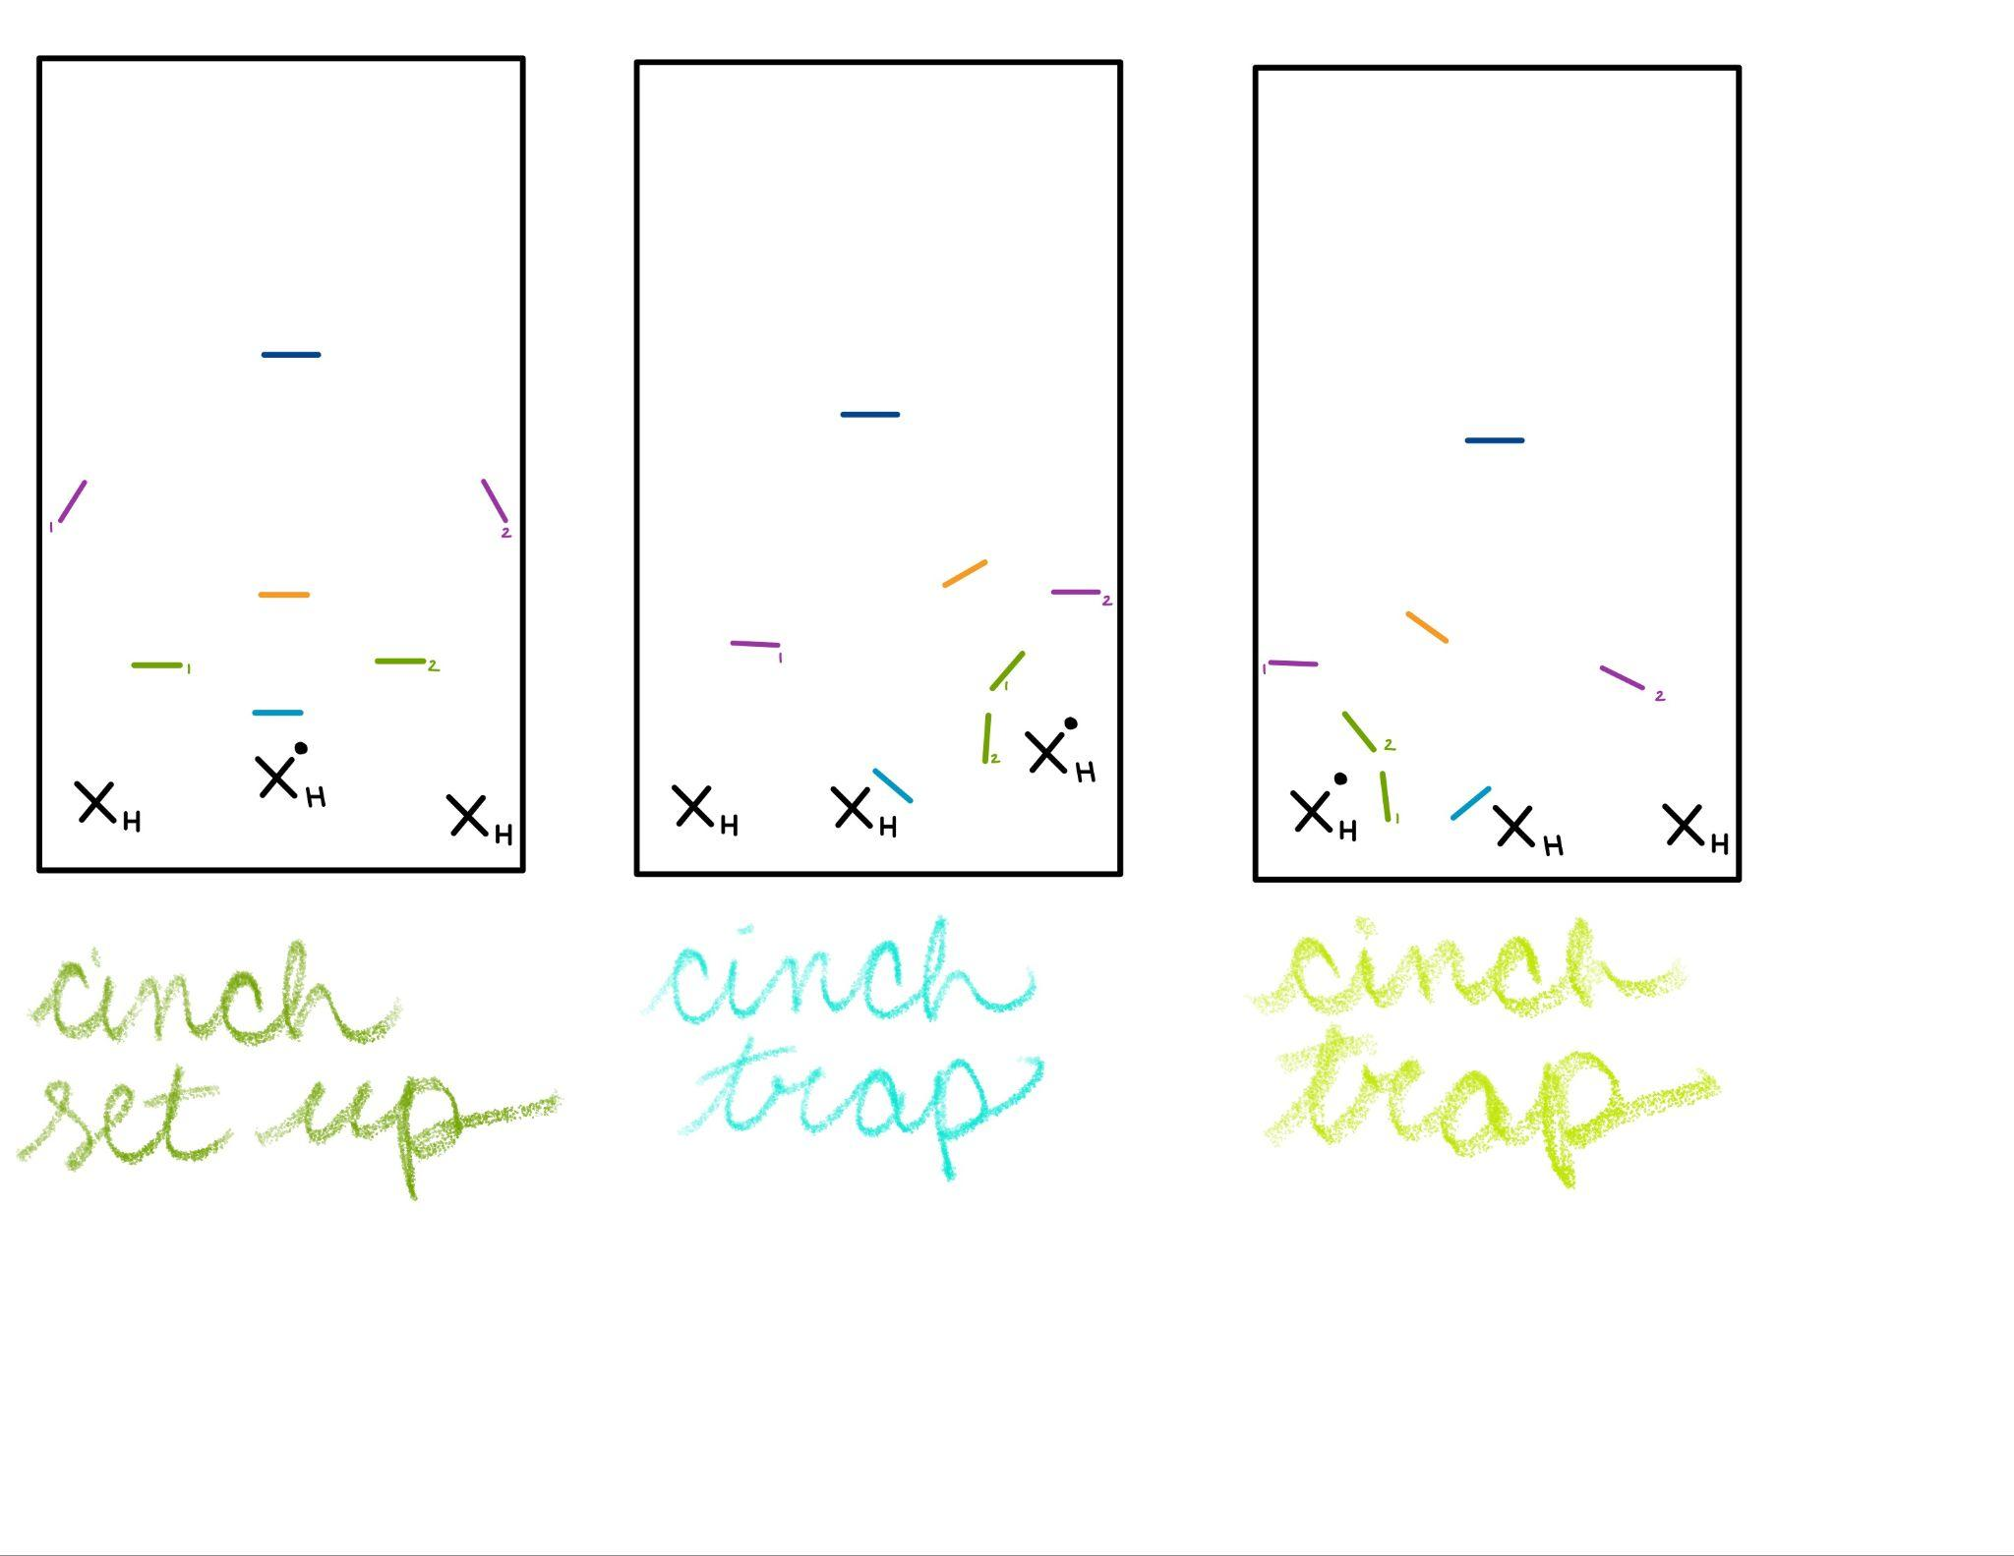
Cinch Zone Positions
Head – Mark thrower flat and count stalls
Ears – Create a flat “V” shape with the head – prevent inside throws
Be passive when reset handlers are back field
Be aggressive when reset handlers try to gain yards
Wings – Secondary line of defense, prevent upfield continuations
Take the player in your zone, communicate with mid-mid and other wing
Butt to sideline and shoulder checking
Mid-Mid – Prevent breaks through head and ears – move with them
No threats in front of you, then move back
Pass off players to wings as they leave your zone
DO NOT LEAVE THE MIDDLE
Deep – Prevent long shots
Pinch in closer if no one is in your zone
Communicate to mid-mid and wings any incoming threats

Slide 4
Cinch Zone: Sideline Trap (Home Side)
Head – Person defense on handler dump
Ear 2 – Mark
Ear 1 – Middle of cup
Wing 2 – Top of cup
Mid-mid – Pinch in to cover holes
Wing 1 – Pinch in to cover open space
Deep – Cover deep space, if no one is in your zone pinch in

Slide 5
Cinch Zone: Sideline Trap (Away Side)
Head – Person defense on handler dump
Ear 1 – Mark
Ear 2 – Middle of cup
Wing 1 – Top of cup
Mid-mid – Pinch in to cover holes
Wing 2 – Pinch in to cover open space
Deep – Cover deep space, if no one is in your zone pinch in

Slide 6
Cup Zone
Use for windy games

Slide 7
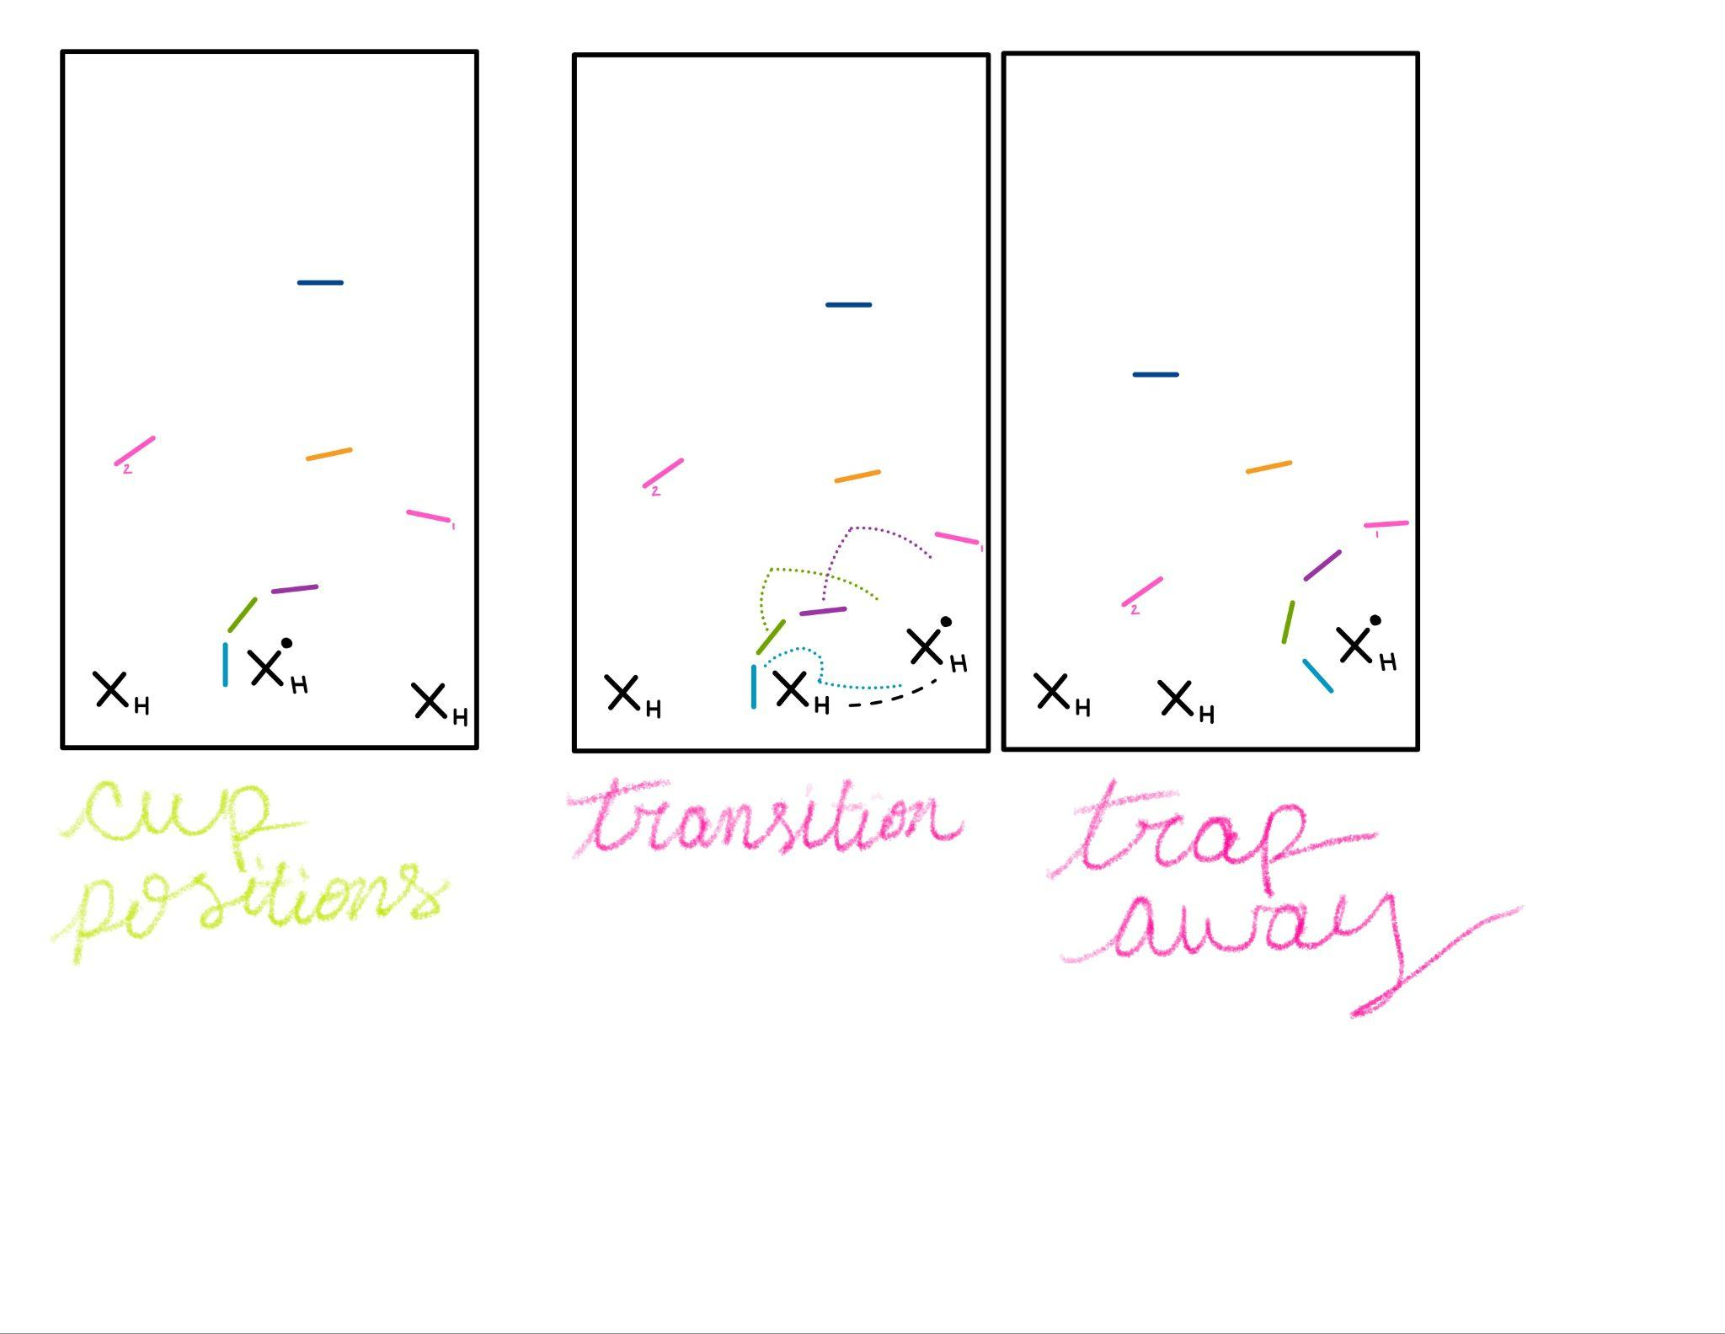
Cup Zone Positions
Heel – Mark and count stalls – NO BREAKS
Mid – Close the gap between you and the mark
Toe – Close the gap between you and mid
** HEEL, MID, TOE MOVE AS A UNIT!!!***
Wings – Prevent upfield continuations – DON’T BITE ON BACK FIELD
Mid-mid – Prevent breaks through cup, communicate with cup about “crashes”
Deep – Prevent long shots

Slide 8
Cup Zone: Sideline Trap (Home Side)
Heel – circle reset handler and cut off throwing lane while moving to mark new thrower – mark back field
Mid – move wide and close in on cup – close gap between you and heel
Toe – move wide and close in on cup – close gap between you and mid
Wing 1 – take away upfield progression while cup is moving – close off the cup
Wing 2 – move back field to cover resets and person in your zone
Mid-Mid – move towards cup to cover holes – don’t stay too close
Deep – move infield and cover player in your zone

Slide 9
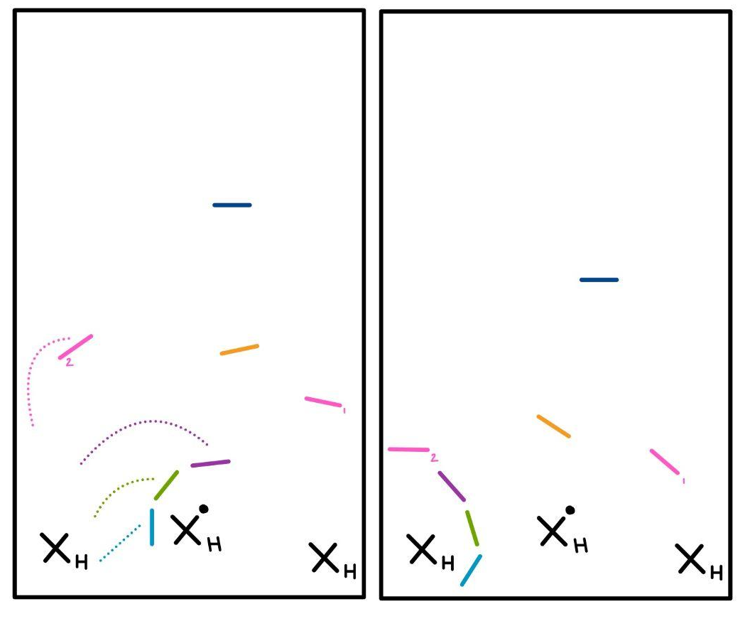
Cup Zone: Sideline Trap (Away Side)
Heel – cut off throwing lane to reset handler while moving to mark new thrower – mark back field
Mid – move wide and close in on cup – close gap between you and heel
Toe – move wide and close in on cup – close gap between you and mid
Wing 1 – move back field to cover resets and take person in your zone
Wing 2 – take away upfield progression while cup is moving – close off the cup
Mid-Mid – move towards cup to cover holes – don’t stay too close
Deep – move infield and cover player in your zone

Slide 10
Zone Offence

Slide 11
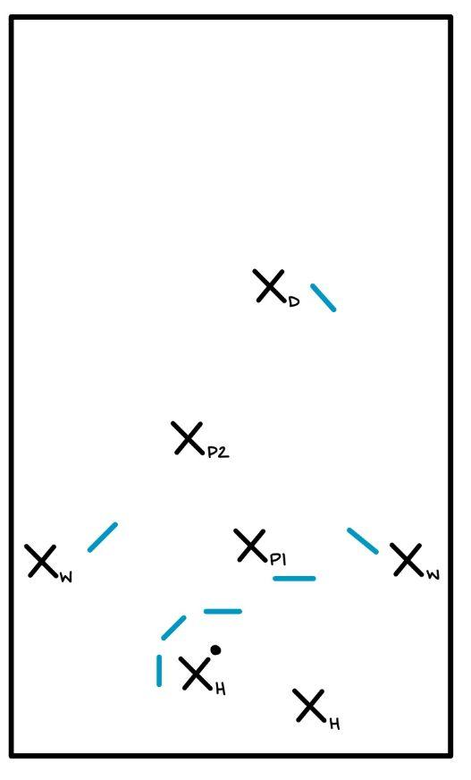
Zone Offence Positions
H1/H2 – Handlers that remain behind the cup and aim to break the disc over and/or through the cup to P1 or P2. They need to work together and keep moving; 90% of the passes in this system will be between them
P1 – Player that aims to receive a short through/over pass from the handlers. ALso works at drawing members of the cup over to create an opening.
P2 – Stays deeper than P1 in order to provide over the top options to handlers. Uses P1 positioning/movement as guide for positioning, identifying the holes that P1 is creating and moving to exploit them
W – Handler wings stay wide and draw the mids out wide. If they receive the disc they are immediately looking to send it back towards the middle of the field
Deep – Stretch the field opening space for the P2 and/or the wings. Set-up to provide an under cut towards the middle of the field any time the P1 or P2 receives the disc

Slide 12
Tips for Zone Offence
If the disc gets to P1/P2 all other downfield players cut towards the receiver to get the next pass
Handlers should rarely throw the disc to the sideline (wings). Should this occur the wings must give the disc back to the handlers IMMEDIATELY – don’t even look up field, catch and return
The third handler will typically either be in P1 position or one of the wing positions

Slide 13
Zone FAQ

Slide 14
When do we put on a zone?
Zone plays will be called BEFORE the start of a point – usually on the line
D-line will generally run zone’s, O-line will only play defense off of turnovers so they likely will not put on zones
Zone’s, usually the cup, are used in windy conditions to force throwers to throw into the wind – traps force the thrower to throw the disc out of bounds and the wind generally helps with this
Zone’s can also be used to slow down a play and shake up the offense – the cinch zone is great for this – this zone will usually be put on and held for a certain amount of throws or distance

Slide 15
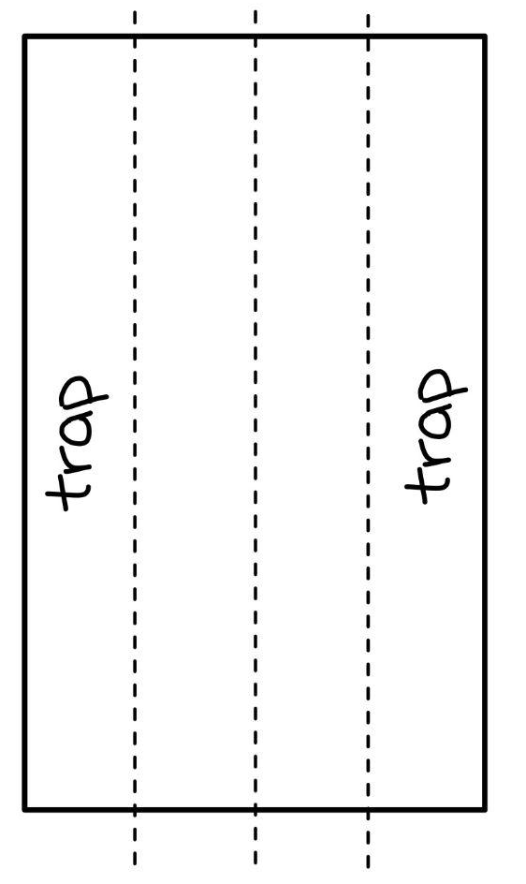
Who calls a trap and when do they call it?
Call a trap whenever the disc is swung from the middle to the first and fourth quarters of the field
The mark calls the trap AS THE DISC IS BEING SWUNG
Call “hold” when the disc is thrown near the sideline, and the trap maintains its shape

Slide 16
What do we do if someone crashes the cup?
A crash is when a cutter or handler runs through the cup trying to get the disc for a stall count reset
The mid-mid or wings should be yelling “crash” when they see someone entering the cup – this alerts the cup to close in
During this time the whole cup can close in on the person with the disc, as long as there are 2 offensive players in the space – all members of the cup close in which takes away all throw options – this will only be 1-2 stalls
As soon as the “crash” leaves the cup you must back up to proper spacing to avoid a double team

Slide 17
When do we melt?
The deep should call “melt” when we are still in control
Calling melt when the zone has been broken is too late
Examples of when to call melt:
After a certain number of passes
After the disc passes a certain point on the field
When holes start to form in the cup – but BEFORE it has been broken

Slide 18
How do we melt?
Cover the deepest threat first!
When you hear “melt” everyone should echo it 3 times
Back up and point at the cleats of which player you’re taking – take the person closest to you
If you notice someone doesn’t have a defender on them, point them out until they are covered
Resume person-defense

Slide 19
How do you break a zone?
SWING!
The most reliable way to break a zone is to tire out the zone
Swing the disc all the way across the field, home side to away side, this forces the zone to run the length of the field over and over again – this tires them out and creates holes in their spacing – that is when you can attack the upfield
The key to breaking a zone is to be calm and not try to rush the point, swing the whole length of the field with the handlers 5 times before attacking up field
Poppers and deep should still be actively trying to get the disc to keep the out-field defenders active
See Zone Offence slide for more details

